Slide 1

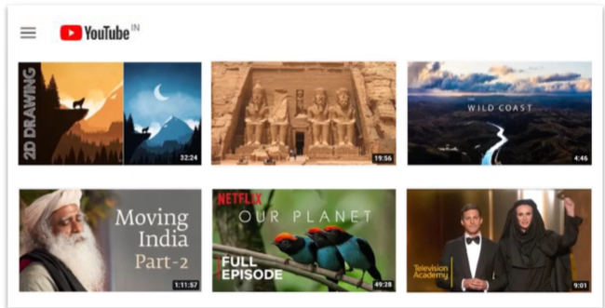
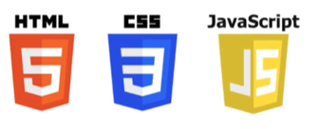
What is Web Development
Web development is known as website development or web application development.
Web development includes front-end programming languages such as:
CSS is used for styling.
HTML provides the basic structure for web pages.
JS is used primarily by web browsers
to create a dynamic and interactive experience for the users.

Slide 2
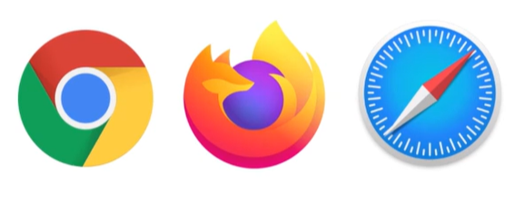
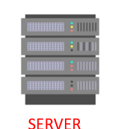


The web development creates, maintains, and updates web development applications using a browser.
This web development requires web designing, backend programming,
and database management.
The development process requires software technology.
Web development creates web applications using servers
Web development requires server-side programming
Language or technology.
Mostly Java, PHP, and other server-side languages require for web development.

Slide 3

What Is Java in Web Development?
Java is one such programming language and was designed to create content for the early World Wide Web.
It has evolved into one of the best and most comprehensive tools for the creation of enterprise websites, mobile applications, and other server-side and client-side software technologies.
CLIENT

Slide 4
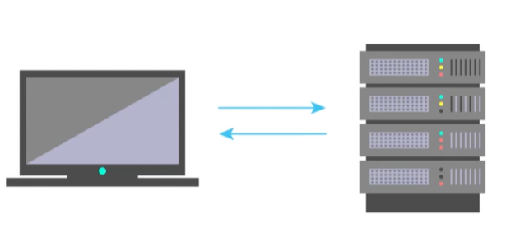
Java Web Application
A web application helps clients to interact with the server and access information.
Java is perfect for developing large web applications too because of its ability to communicate with a large number of systems.
Services like peer-web services, database connectivity, and back-end services can also be accessed via Java web development.

Slide 5
Why Choose Java for Web Development
Java offers an unparalleled blend of functionality and efficiency.
Its Write Once, Run Anywhere (WORA) capability makes it a sought-after choice for developers.
Below are some compelling reasons to use Java for web development:
Scalability
Security
Community Support

Slide 6
How is java used for web development?
java can be used in both front-end and back-end development.
The bottom line is that the possible uses of Java in web development are virtually endless.
Indeed, more than 50 million websites use Java for all types of services and dynamic content.
That includes Java’s role in:
online stores
search engines
content management systems
games
social media networks
advertising

Slide 7
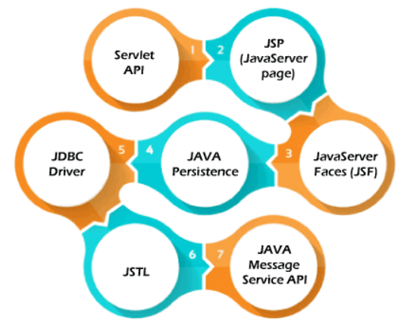
Types of the Java Web Technologies
Servlet API
JSP (Java Server page)
JDBC Driver
JAVA Persistence
Java Server Faces (JSF)
JSTL
JAVA Message Service API

Slide 8
Steps to Develop a Website Using Java
Building a website with Java involves several steps, each with its own set of complexities and requirements.
Step 1: Requirement Analysis
Step 2: Choose the Right Framework
Step 3: Database Design
Step 4: Develop the Backend Logic
Step 5: Implement Security Measures
Step 6: Develop the Frontend
Step 7: Testing
Step 8: Deployment

Slide 9
Functions of Java Web Development
Java web development creates applications and websites using static and dynamic resources.
The static resource refers to HTML pages with images, and a dynamic resource refers to classes, jars, Servlet, and JSP.
Java web development works on three main factors. These development factors show below.`
Front-end web development using Java technology.
Backend web development using Java server technology.
Database management using Java database driver.
The above three factors create, update, remove, display and operate data or information.

